Slide 1
EDA:Online Shoppers Purchasing Intention
Final Project | DS5010
Bolai(Bryan) Yin

Slide 2

Introduction
Dataset:
Concerned Variable: 'Revenue'
Goal:
(whether user made a purchase)
~12,330 sessions on an e-commerce platform
15.5% (1,908) of which were positive class samples ending with shopping.
Identify key patterns associated with purchasing intention

Slide 3
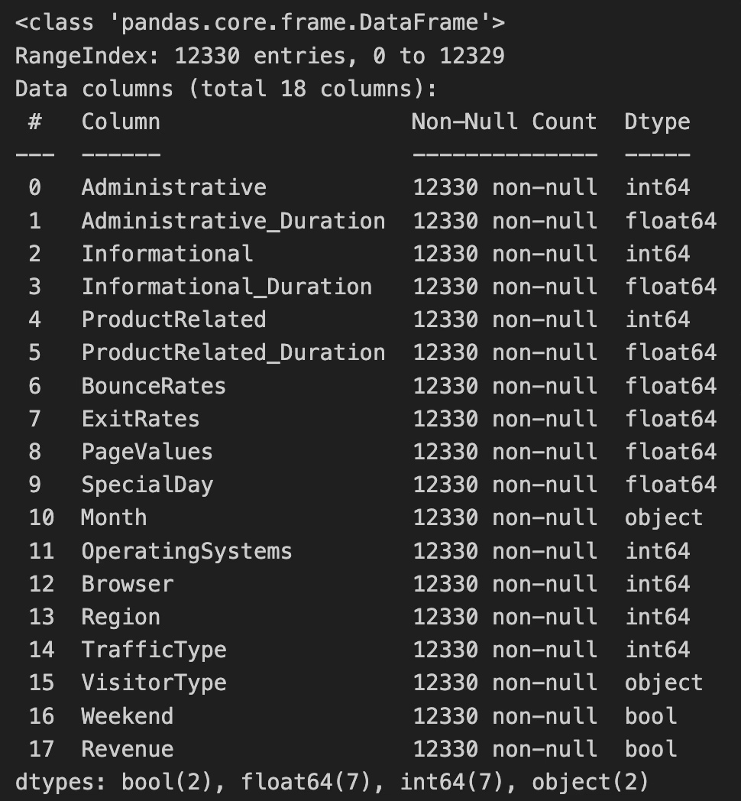
Raw Data Columns
18 features with two types:
Numerical(Time spent on pages, Bounce & Exit Rates, SpecialDay, etc.)
Categorical(Revenue, Weekend, Region, Month, etc)

Slide 4
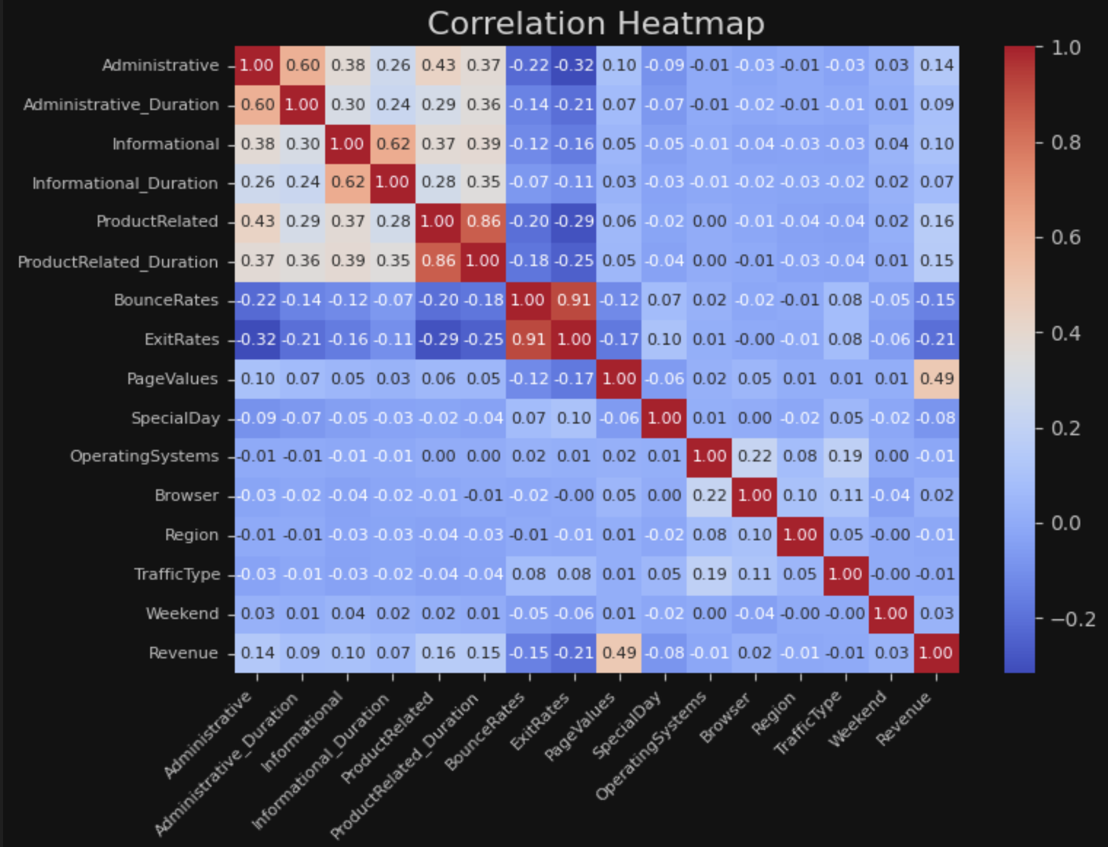
Correlated Features
Strong Correlations:
Moderate Correlations:
PageValues
Cross Pages: Informational, Administrative & Product
Weak Correlation:
ExitRates
ProductRelated & Duration
Administrative & Duration
BounceRates

Slide 5
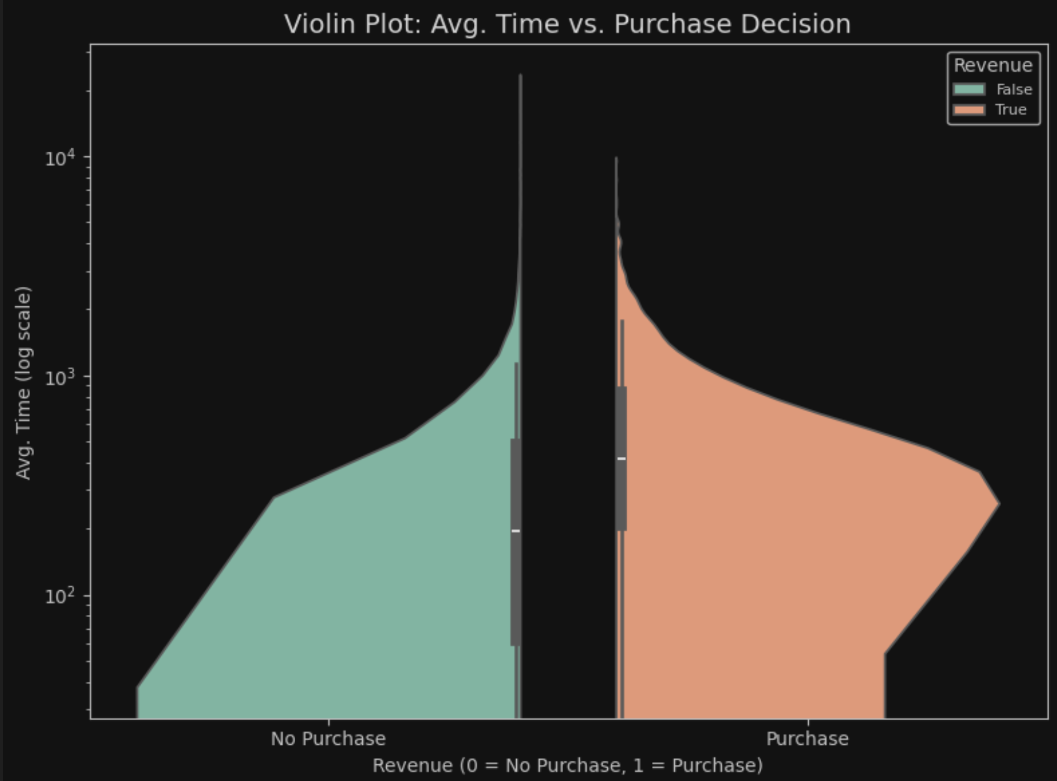
Aeverage Time Spent vs. Purchase
'Avg. Time’ spent across pages
Compare time distribution - Insight: Purchasers generally spend more time

Slide 6
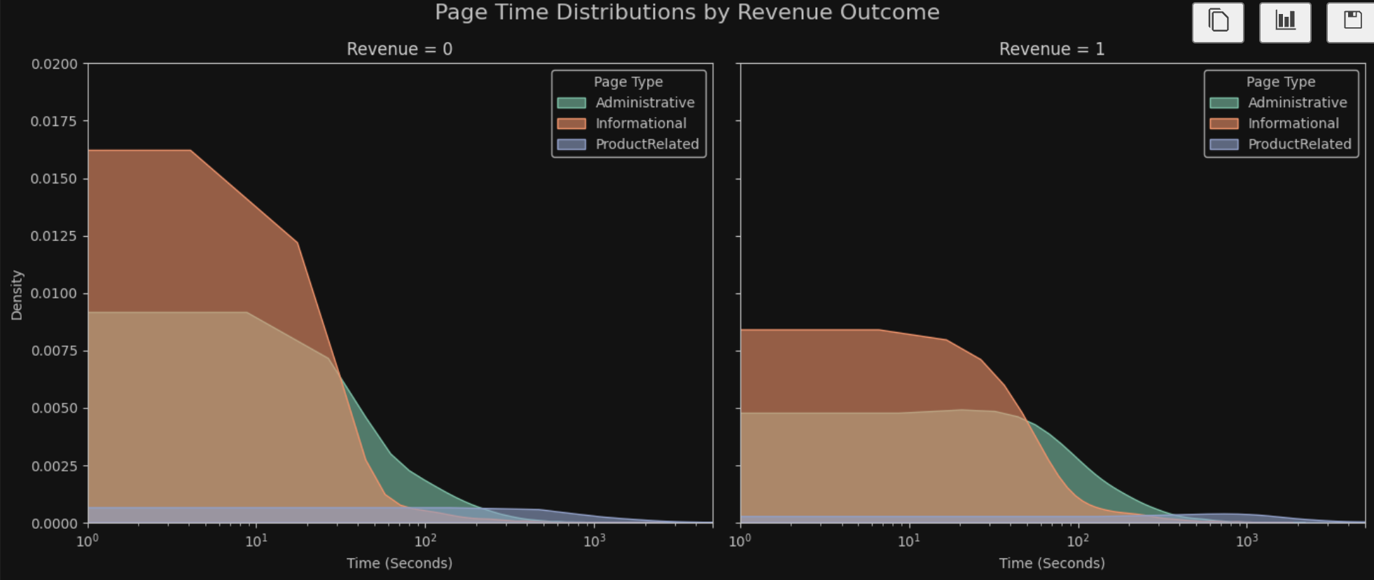
Types of Duration vs. Revenue
Regardless of purchase outcome, spend little time on each page type.
ProductRelated pages show similar duration distributions across both scenarios
Administrative and Informational pages have slightly higher densities for non-purchasers.
The log scale highlights a strong right skew across all page types.

Slide 7
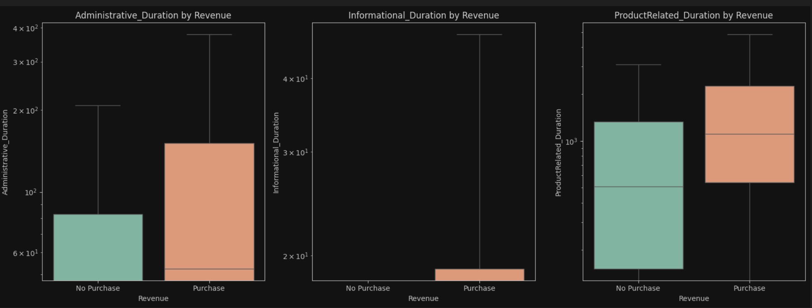
Types of Duration vs. Revenue(Contd.)
The median line is barely visible or merged with the lower quartile, especially for Informational_Duration, likely due to strong left skewness (many small values)
ProductRelated_Duration shows a clear difference: median and upper spread are higher for Purchase.
Whiskers are long due to extreme outliers, which dominate the scale

Slide 8
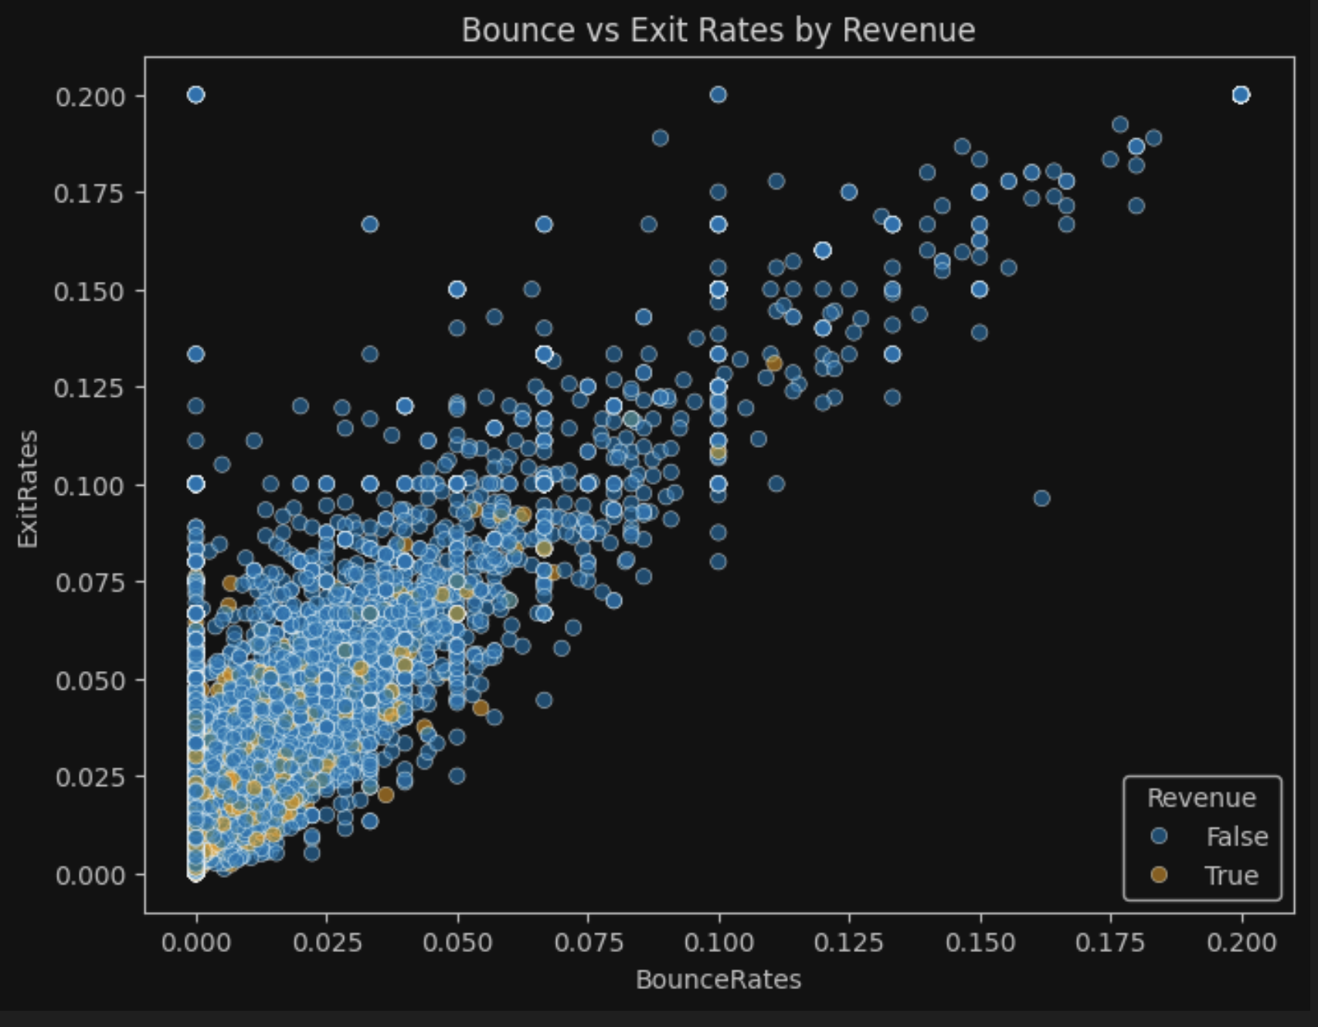
Bounce & Exit Rates vs. Revenue
“True” dots are clustered in the bottom-left corner
Insight: Lower rates associated with higher likelihood of purchasing

Slide 9
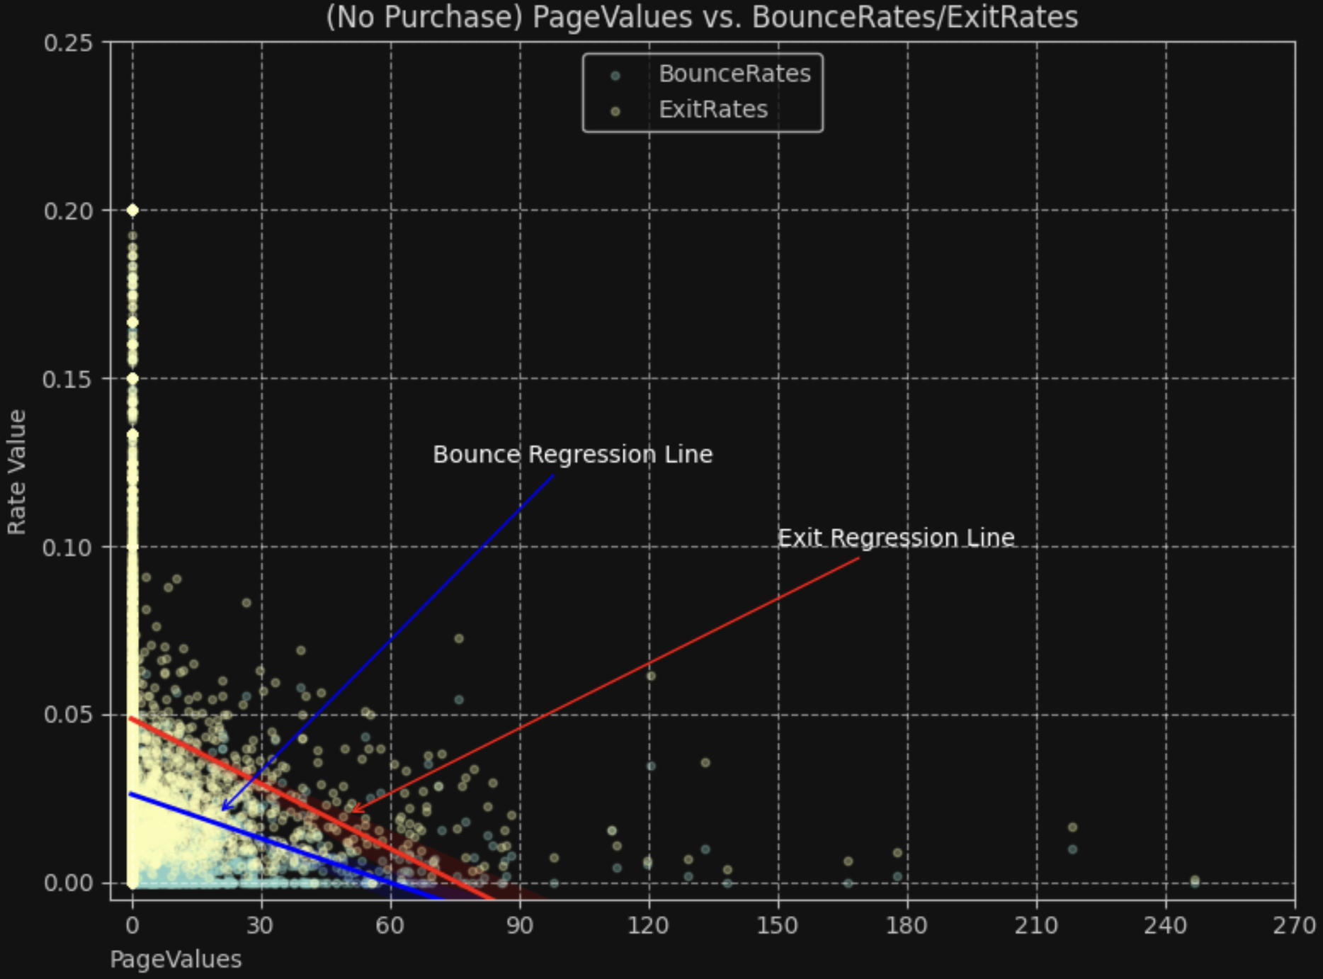
No Revenue Samples (Bounce & Exit Rates)
No Purchase samples are densely clustered in those low PageValues(<30)
Steeper regression line on exit rate
Different Threshold:
Bounce reduces to zero at lower PageValues, which implies more effectiveness gained even via moderate

Slide 10
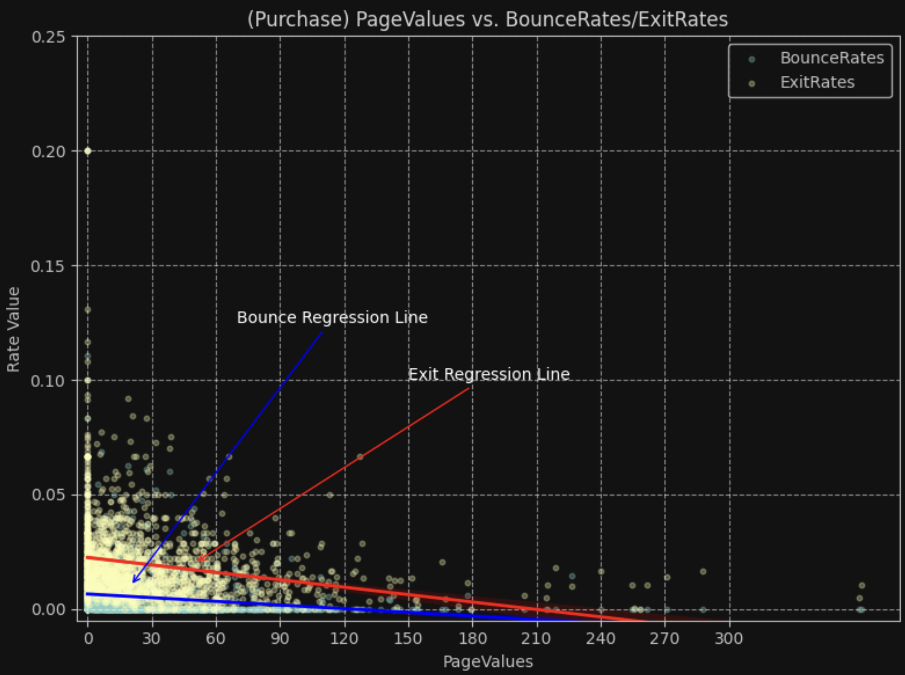
Revenue Samples (Bounce & Exit Rates vs. PageValues)
Flatten two lines compared to the previous scenario.
Relative steeper for Exit Line when it declines
High returns for reducing exit rates through page optimization

Slide 11
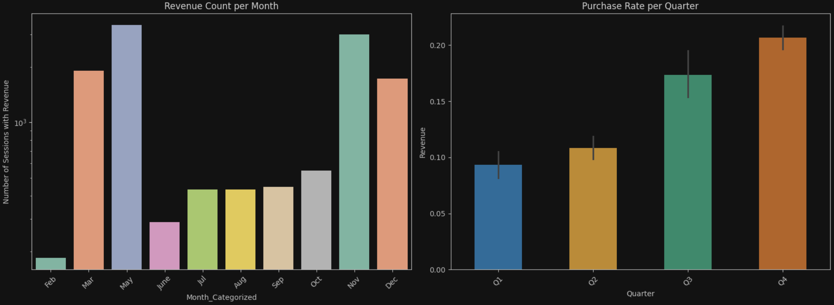
What’s Revenue behavior look like through a year?
Revenue ratio increase quarterly
The spikes in March & May is likely attributed to Spring Break, Mother’s Day and Memorial Day
Hallowean, Thanks-giving, Black Friday and X’mas holiday boost engagement in Q4 as always

Slide 12
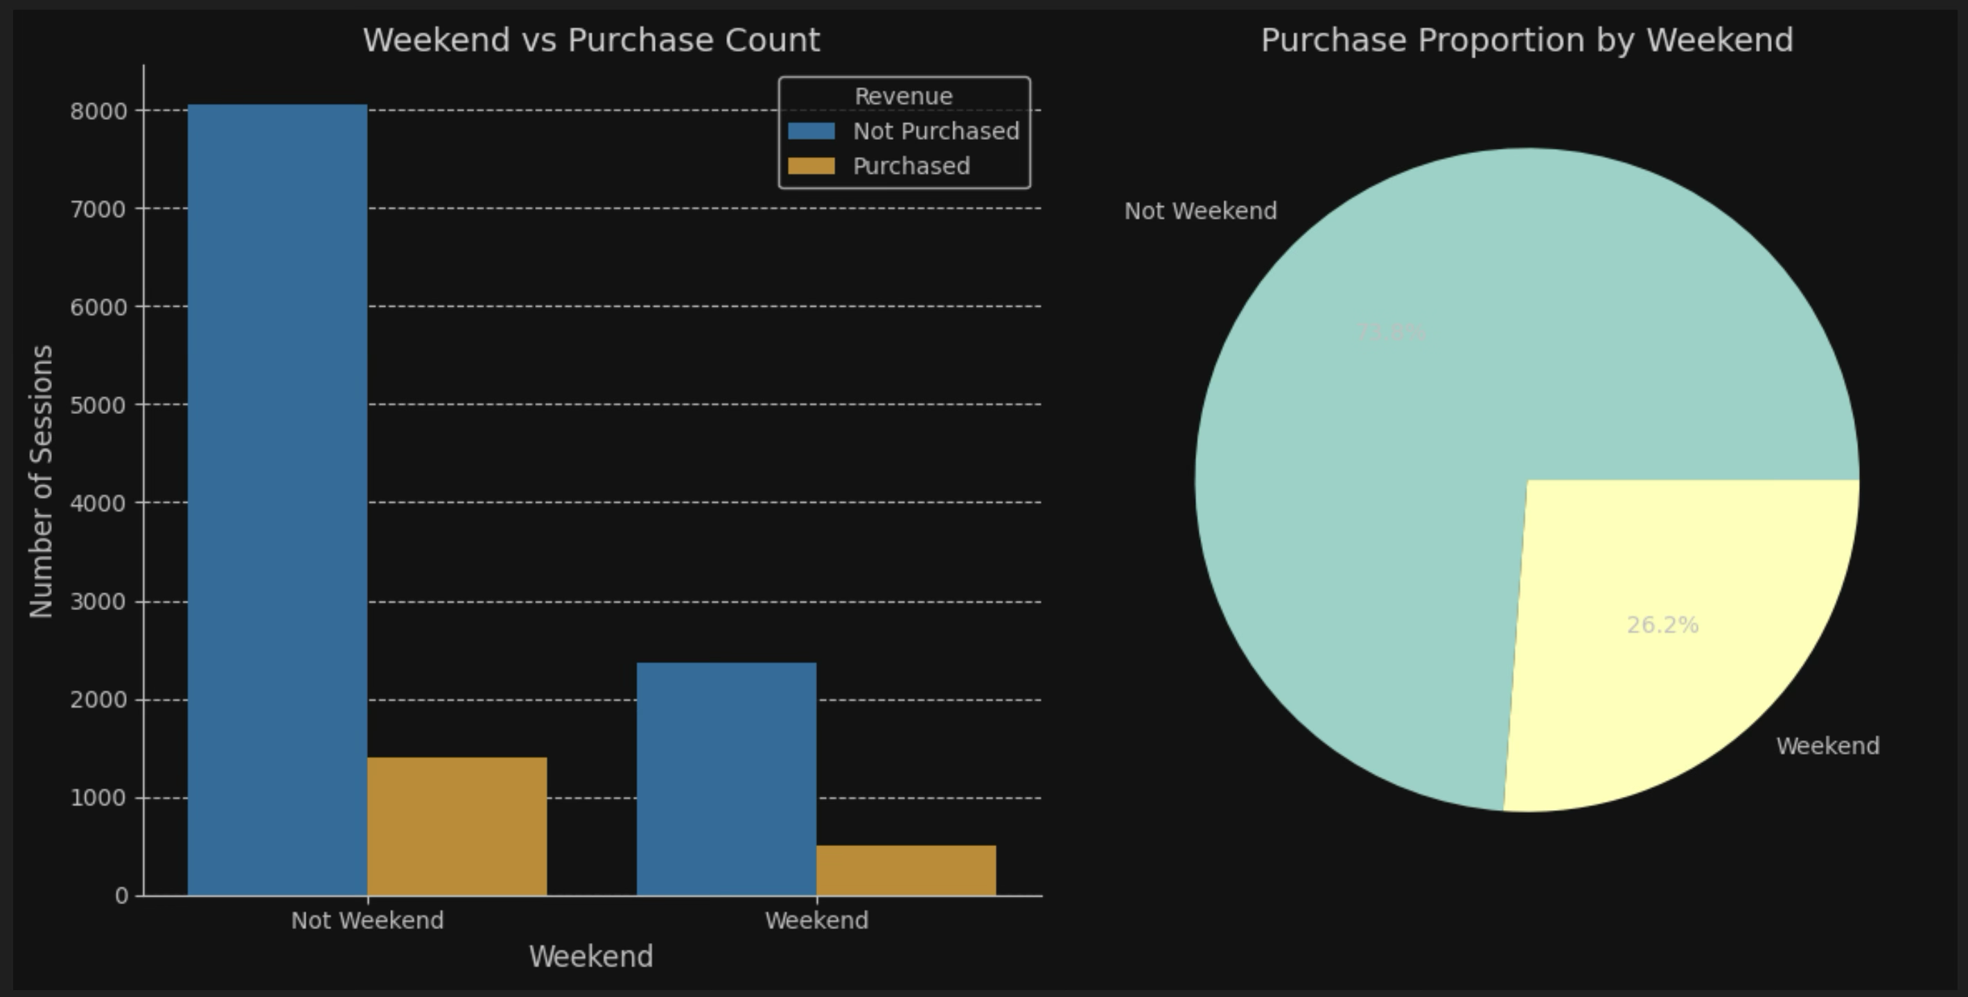
Weekend & weekday?
People in this dataset are willing to purchase in weekdays rather than weekend.

Slide 13
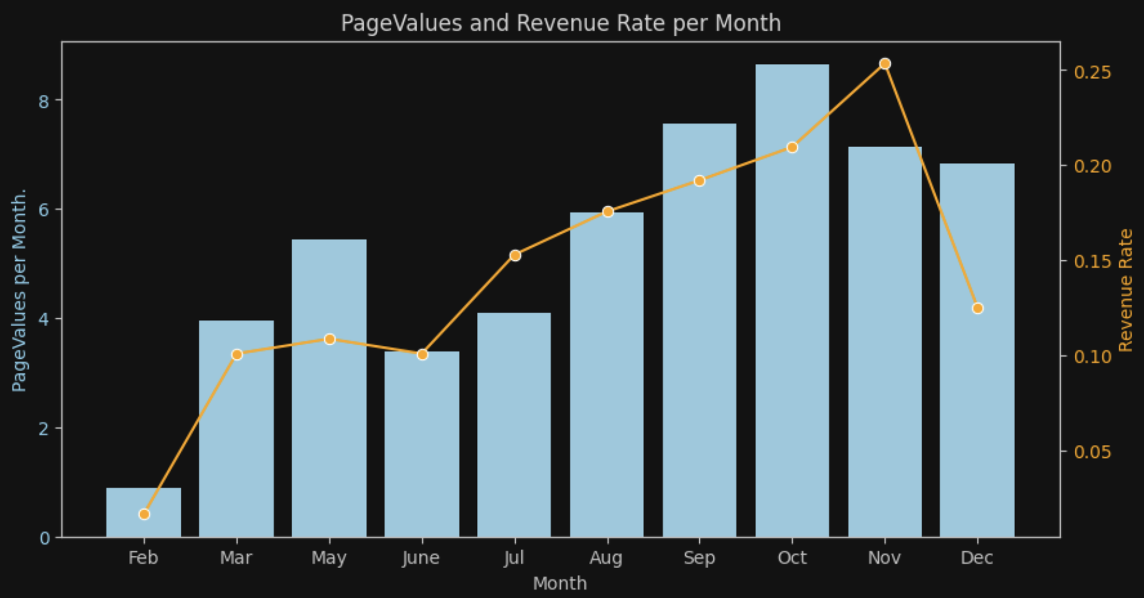

Purchase Rate correlates to PageValues
Revenue rate goes up through months
Clear positive relationship between PageValues(avg. per month) and Purchase Rate
Probably another influence factor as revenue ratio drops sharply in Dec

Slide 14
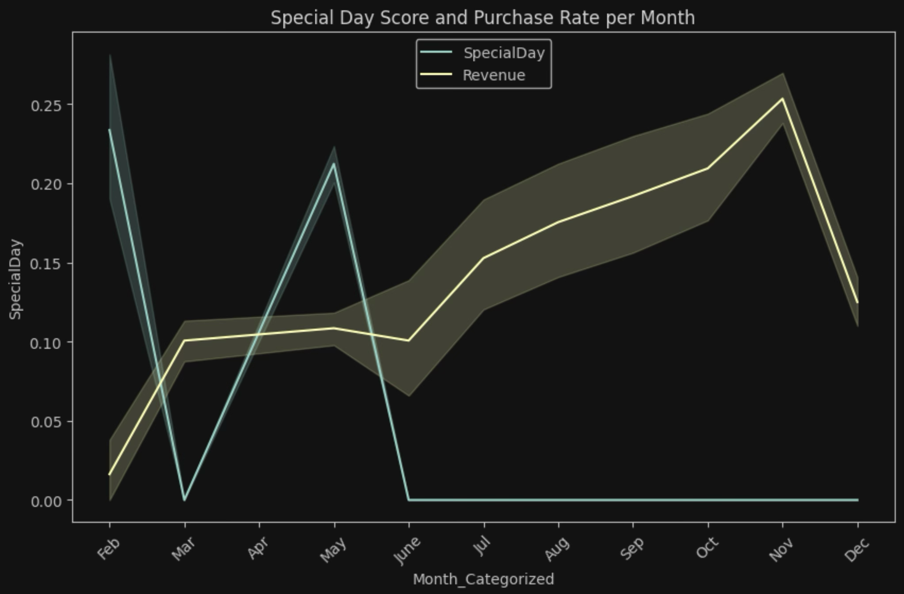
Special Day vs Revenue Rate
‘Special Day’ variable doesn’t seems to have strong correlation with revenue ratio

Slide 15
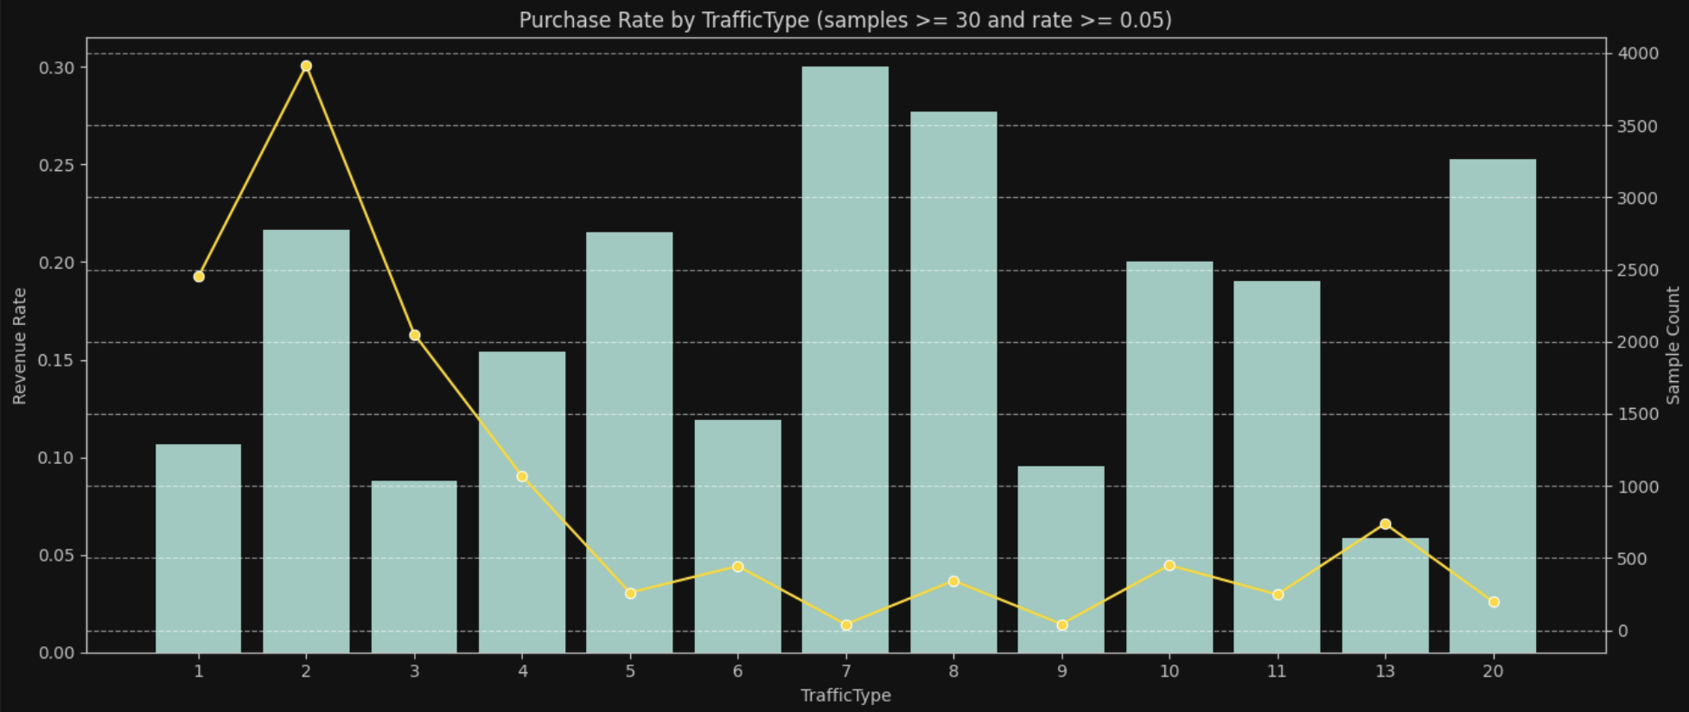
Traffic Type Contribution
Traffict Type: 7 has the highest revenue ratio with less number of session(high conversion ratio)
Second highest is Trafic Type: 8
Outlier : Extremely small samples (n=1, n=10) are likely noise—prioritize high-volume channels for actionable insights.

Slide 16
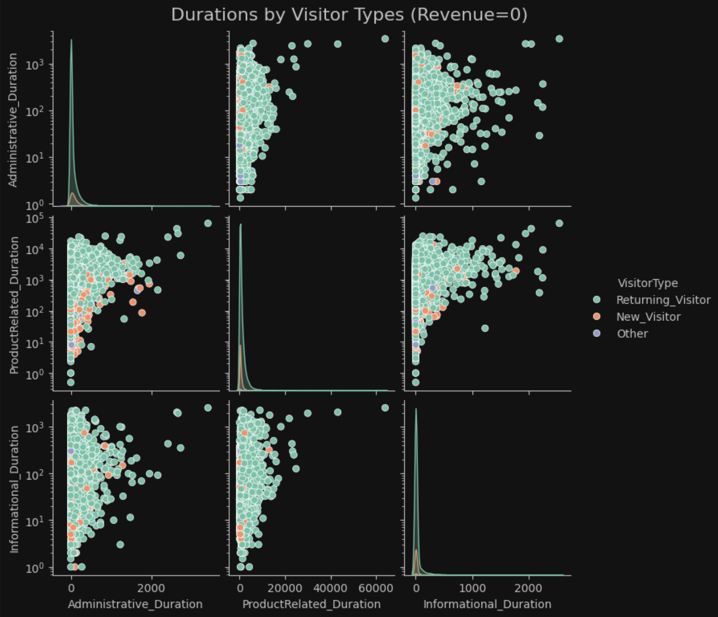
Duration vs. Vistor Types
Majority of samples are returning vistors
Some new visitors spend more time viewing administrative pages than informational pages when they’re viewing product.

Slide 17
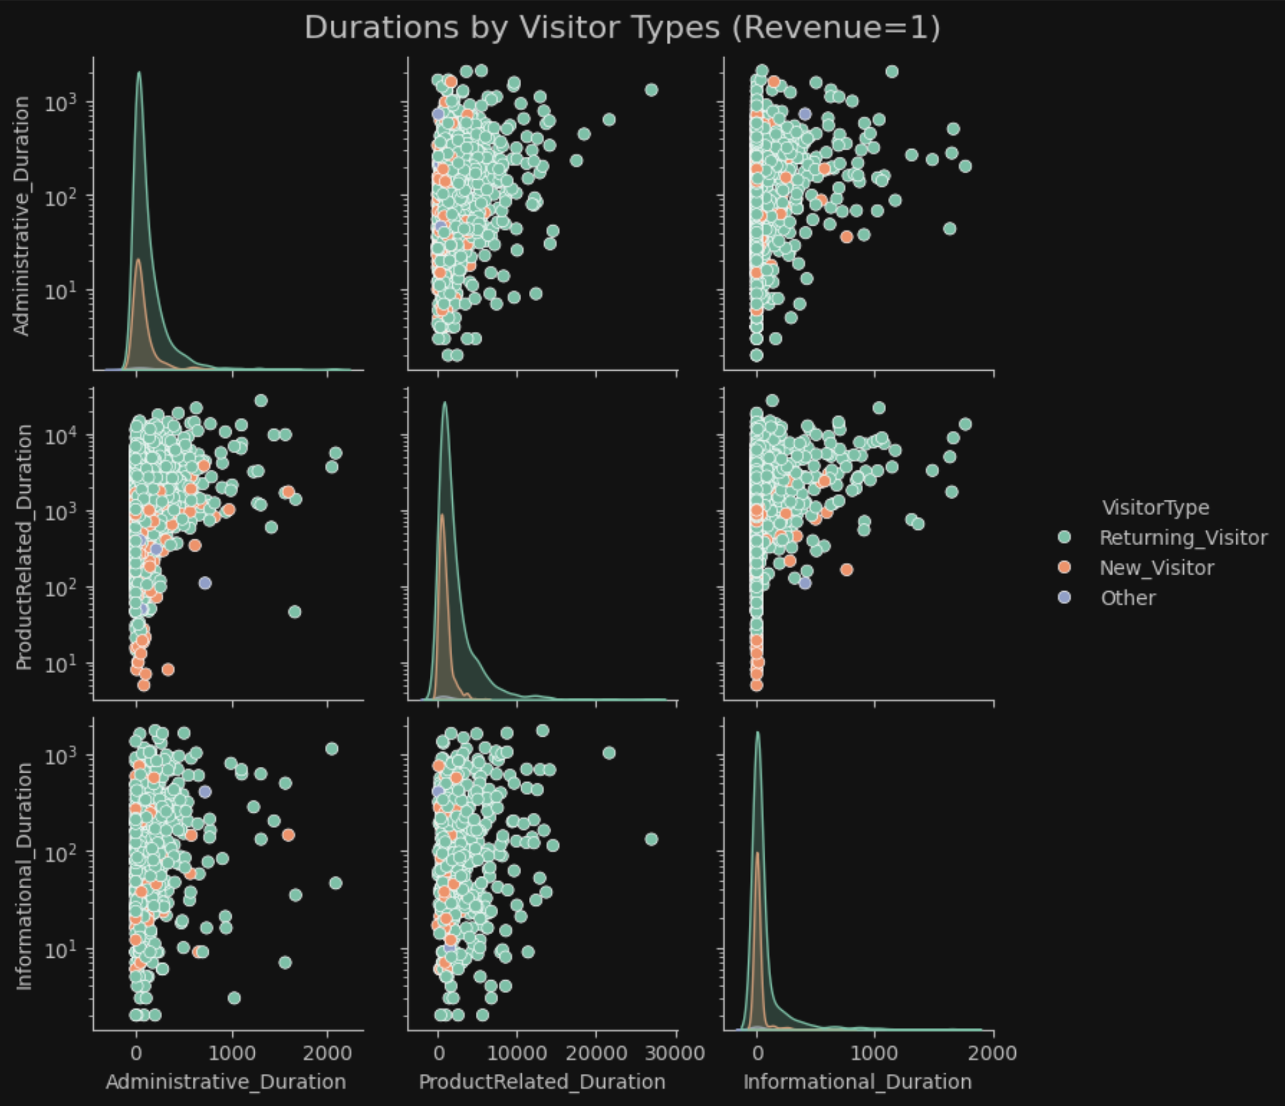
Duration vs. Vistor Types (Con.)
Majority of samples are returning vistors
New visitors spent more time on ProductRelated pages

Slide 18
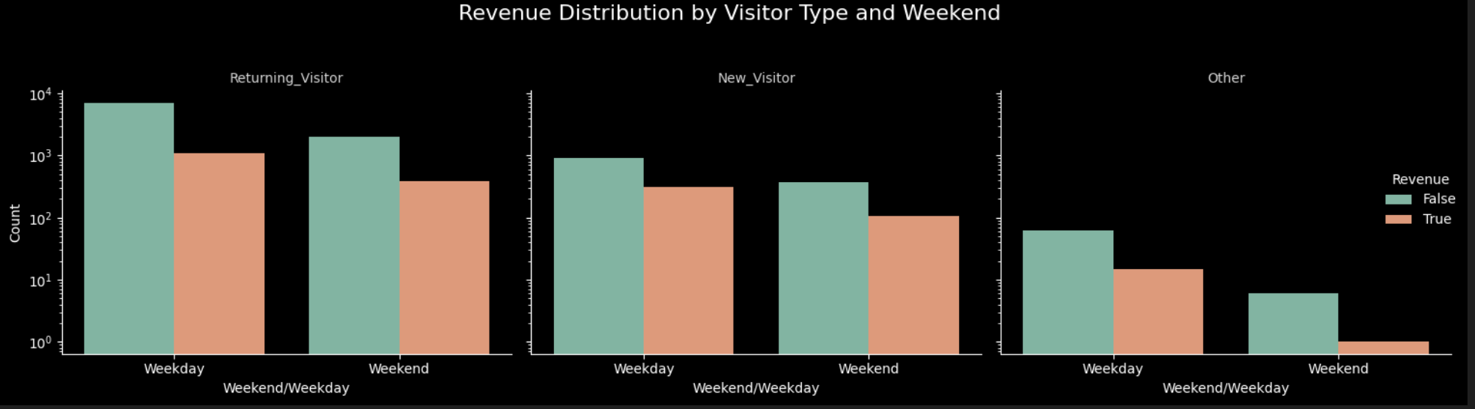
Visitor Types vs. Weekend
No too much behavior difference on this dataset
Returning visitor has higher number of purchase in weekday; same to the new visitors

Slide 19
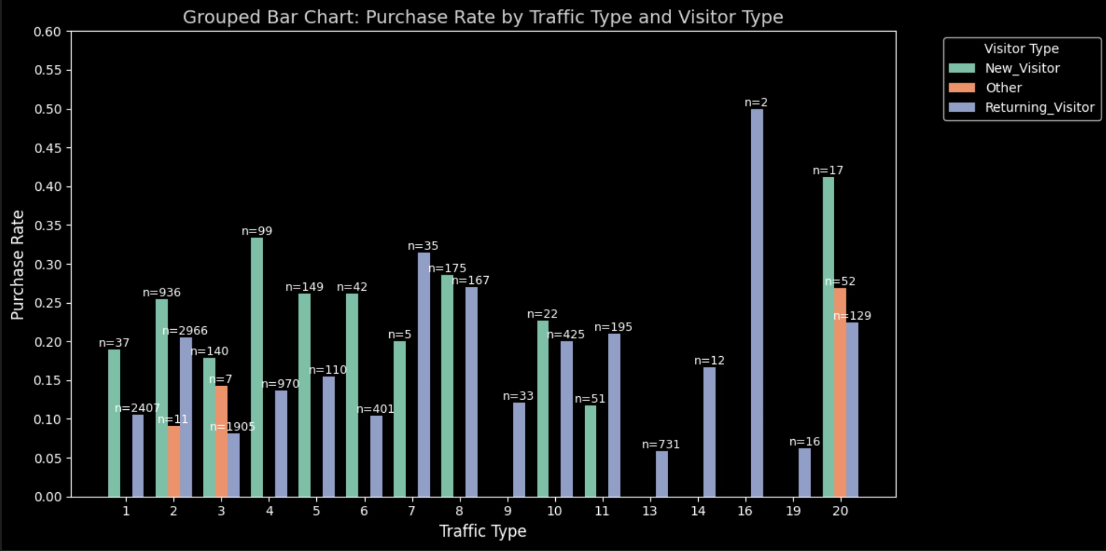
Visitors vs. Traffic Types
Majority of returning visitors like to use type:2, which also contribute high revene ratio for new visitors.
Other types likes to use traffic type:20, and some of them uses traffic type 2 and 3.

Slide 20
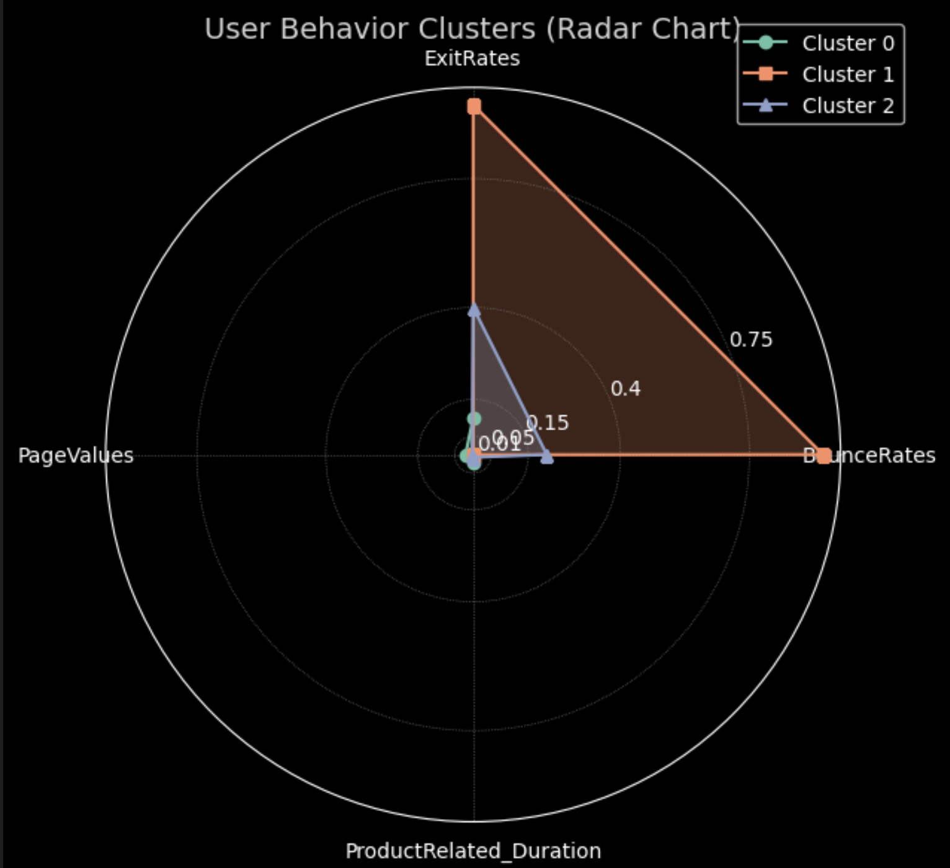
Radar chart shows distinct behavior patterns across 3 clusters
Cluster 0:
relatively high engaged visitor
Spend relatively more time on pages
Clustor 1:
Extremely High Bounce Rates and elevated Exit Rates.
PageValues and ProductRelated_Duration near zero.
Cluster 2:
Exit Rates close to Cluster 1, but nuch lower Bounce Rates.
Viewing less pages

Slide 21
Key Takeaways
High PageValues and Product Page engagement → Higher likelihood of purchase, which can be identified through visual exploration of feature relationships using Matplotlib and Seaborn. These tools help us identify patterns in user behavior and make data-driven marketing decisions.
Clustering reveals clear user behavior segments: Using KMeans for clustering, I leveraged unsupervised learning techniques to segment users based on key features like BounceRates, ExitRates, and PageValues. Visualization through Seaborn's pair plots and Matplotlib's radar charts helped visualize these groups and their distinct behaviors.
Bounce Rates and Exit Rates are critical predictors of early exits, emphasized through bar plots and heatmaps. These visualizations help us understand the correlation between high BounceRates and ExitRates with the likelihood of churn, offering valuable insights for improving user engagement.
Temporal trend analysis: Line plots from Matplotlib helped identify seasonal patterns in user behavior, aiding in adjusting marketing strategies based on the time of day, week, or promotional cycles.

Slide 22
Future
In this project, KMeans clustering was used to segment users based on their behaviors, and further applied Matplotlib and Seaborn to visualize these segments and understand their characteristics, which are crucial for predictive modeling.
For future steps, integrating supervised models (such as logistic regression or random forests) can predict conversion likelihoods, while leveraging time-series analysis techniques (e.g., ARIMA) could forecast future user behaviors. Using Seaborn's advanced visualizations and Matplotlib's flexibility, I aim to build detailed, informative graphics to aid in the optimization of marketing and product strategies.

Slide 23
Thank You
Questions

